Slide 1
One Axis Drill Progress
18.06.2023

Slide 2
What has been accomplished this week:
Circuit Simulation in Proteus
Importing Solidworks Design to MATLAB

Slide 3
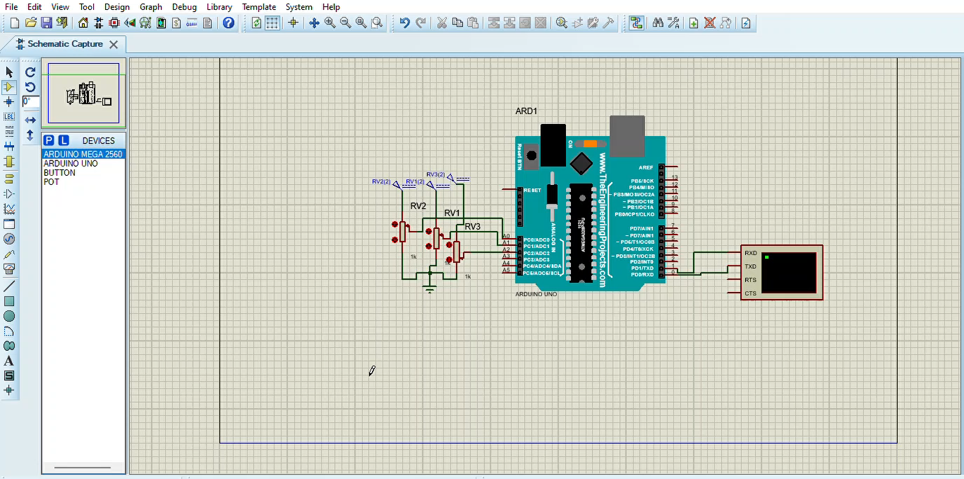
Accelerometer simulation using variable resistors

Slide 4
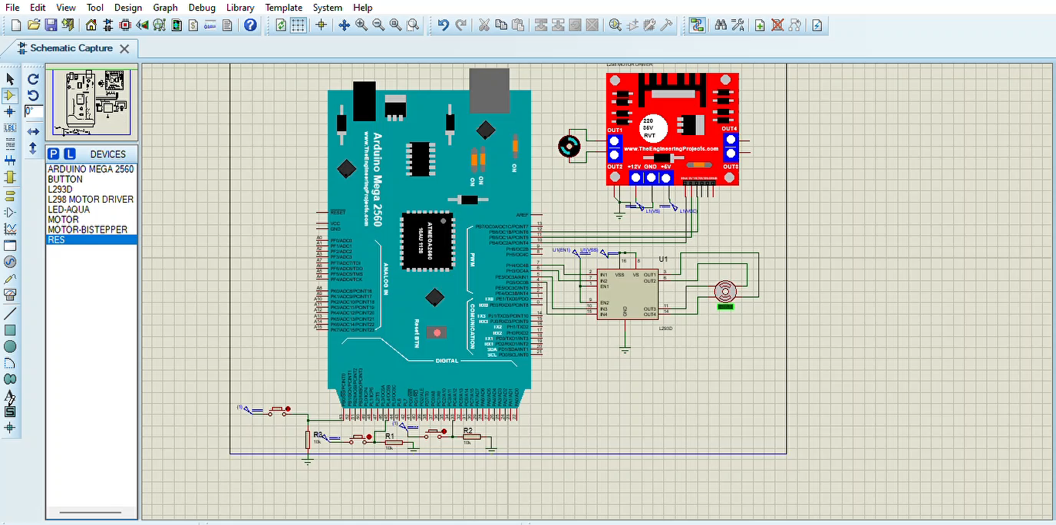
DC and Stepper Motor Control using limit switches(push buttons in Proteus)

Slide 5
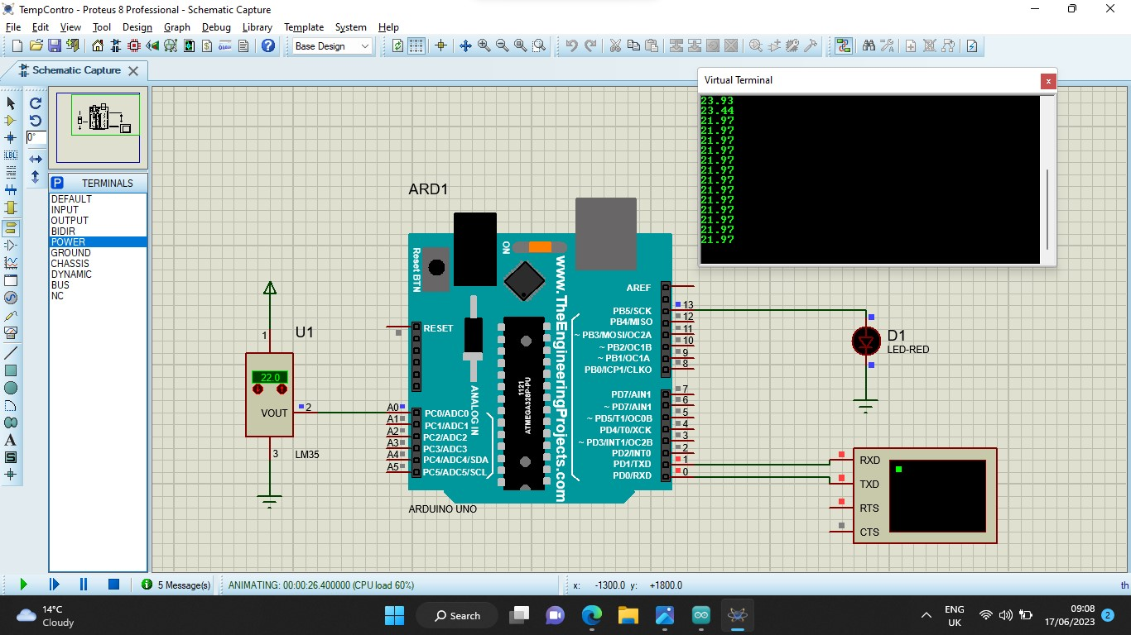
Temperature Sensor Simulation

Slide 6
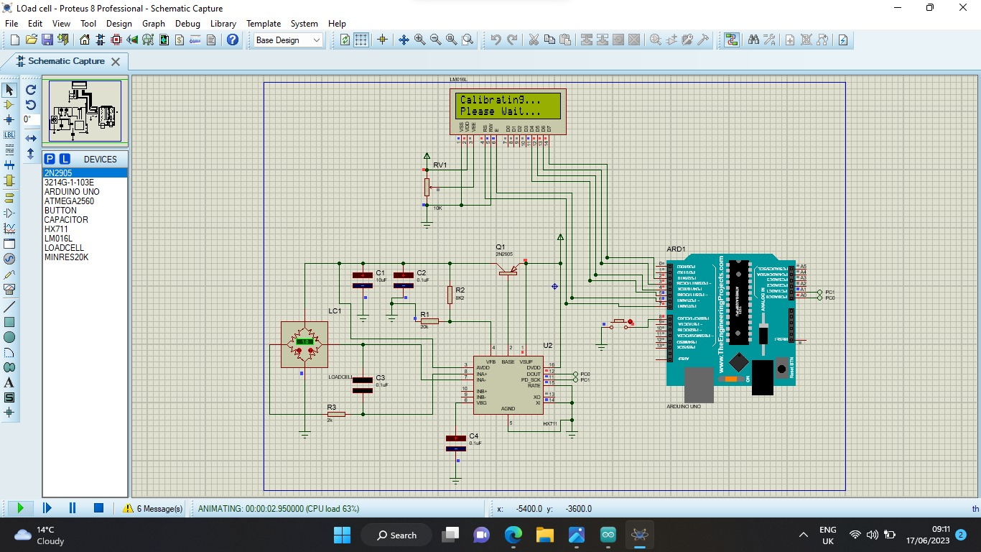
Load Cell Simulation

Slide 7
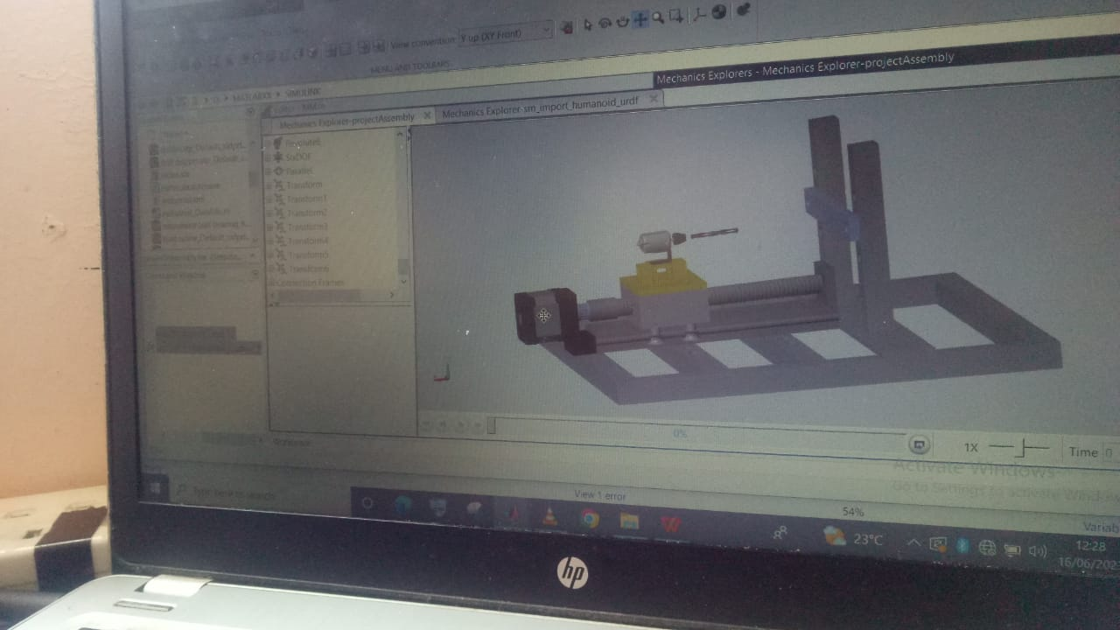
Importing Mechanical Design to MATLAB

Slide 8
ANOVA analysis to determine dependence of feed and drill speeds

